Slide 1
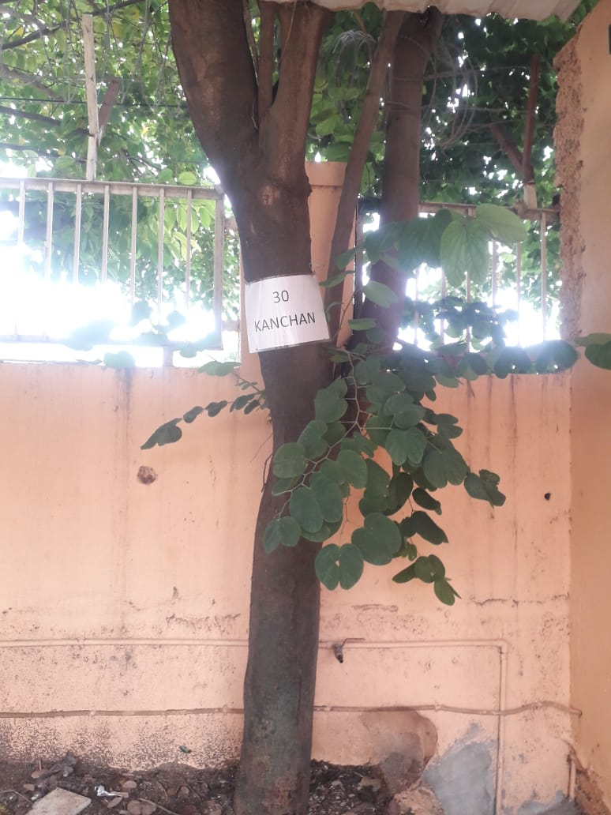
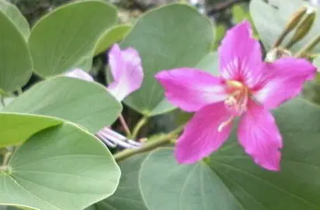
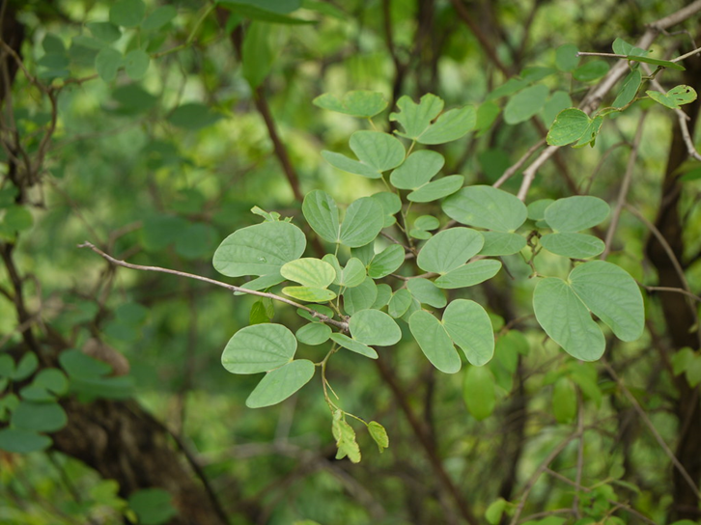
Kanchan
Near Turf court AIS Campus, Wakad.

Slide 2
Common name : Orchid Tree ,Kachnar
Scientific name : Bauhinia acuminata
Family : Fabaceae
Habit : Kanchan has a moderate growth shrub habit.
Distribution : Kanchan is native to tropical Southeastern Asia like
India, Sri Lanka, Thailand, Malaysia, and
Indonesia.

Slide 3
Description
Kanchan or Bauhinia acuminata is a small to medium-sized tree.
It is notable for its distinctive, orchid-like flowers which are usually pink or white.
The tree has a moderate growth habit, often reaching heights of 5 to 10 meters(16 to 33 feet).
It typically features a spreading canopy and is valued for its attractive foliage and flowers.

Slide 4
Uses :
Kachnar is commonly used in Ayurvedic medicine to support thyroid function and balance thyroid hormones. It helps reduce swelling and inflammation of the thyroid gland, promoting overall thyroid health.
its utility as antitumour, antimicrobial, anti-inflammatory, anti-goitrogenic, hepatoprotective and haemagglutination.
Kachnar leaves are beneficial in managing diabetes by reducing blood glucose levels and improving lipid profile due to the presence of antioxidants.
In Ayurveda, applying Kachnar powder mixed with honey helps manage skin problems such as acne, pimples.
Kachnar leaves are beneficial in managing diabetes by reducing blood glucose levels and improving lipid profile
Kachnar helps in wound-healing

Slide 5
Ornamental :- It is commonly grown for its attractive, orchid-like flowers
and lush foliage, making it a popular choice for landscaping
and garden decoration.
Cultural :- The plant holds cultural significance in some regions, often
used in traditional ceremonies or as part of local customs.
Medicinal :- In traditional medicine, various parts of the plant are used
for their purported health benefits.
Examples :- The leaves and flowers are sometimes used in
remedies for digestive issues and skin conditions.

